Slide 1
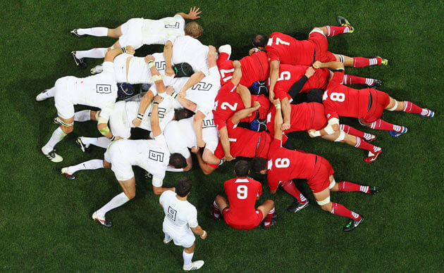
S tudents C reating R eally U norganized M esses
5/01/2017 Net World Sports http://www.brandproject.com/wp-content/uploads/2014/03/rugby-scrum.jpg
Chris Spaulding
Manoj Vasa
Kyle Varney
Michael Roach

Slide 2
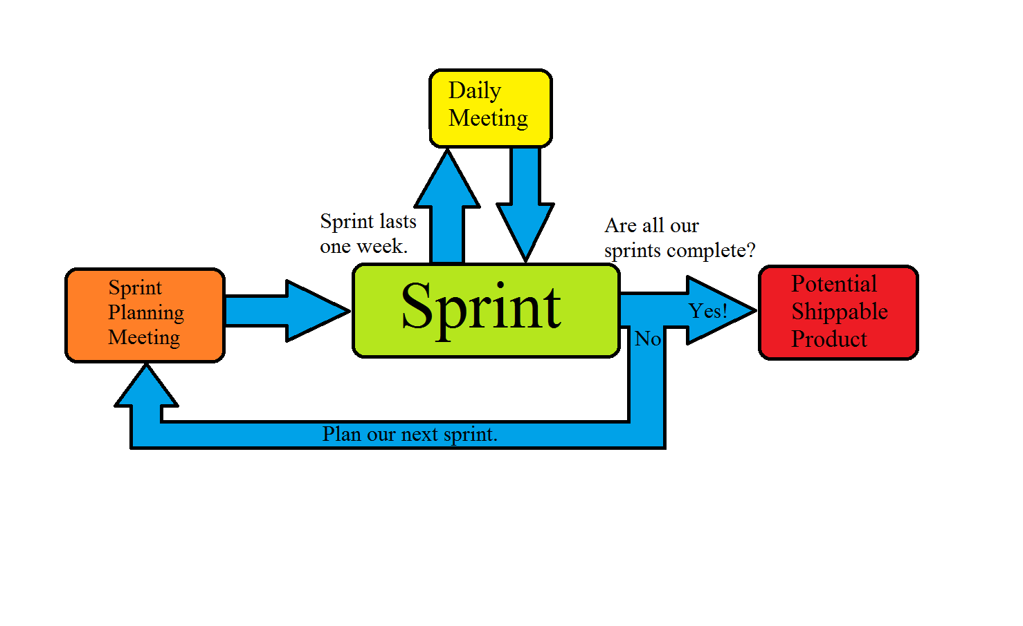
SCRUM Process model

Slide 3
Process Model
What we liked
What didn’t work
What we would change our

Slide 4
Take away
Don’t sacrifice maintainability for “working” product.
Lack of maintainability
difficult for team members to catch up on work done.
Makes additional changes difficult
Adding maintainability is hell
It takes more time and effort

